Slide 1



Another Side of Hacking
Raising the Awareness, Honing the Skills
@ STMIK Nusa Mandiri
25 April 2017
Satria Ady Pradana
https://xathrya.id

Slide 2
#Whoami?
Cyber Security Consultant at Mitra Integrasi Informatika (MII)
Researcher at dracOs Dev Team
Coordinator of Reversing.ID
Member of Indonesia Honeynet Project

Slide 3
Today’s Adventure
Learning How Hacker See and Act
Do What Hacker Do (Ethically)
Watching something fun
Get serious in this field

Slide 4
Security
ILLUSION
Is (just)
Or, some say ...

Slide 5
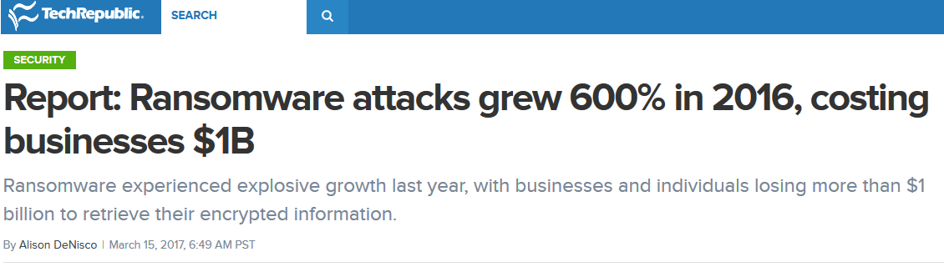
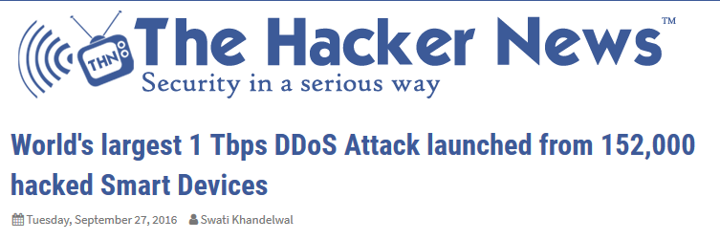
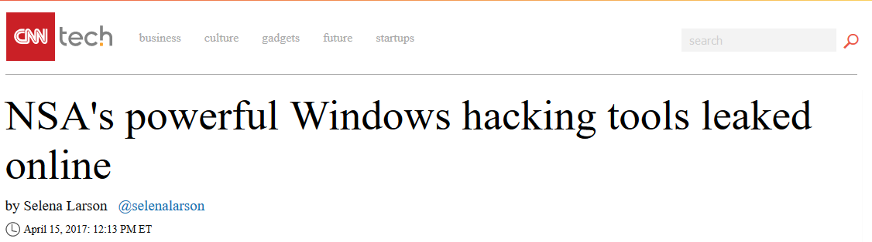
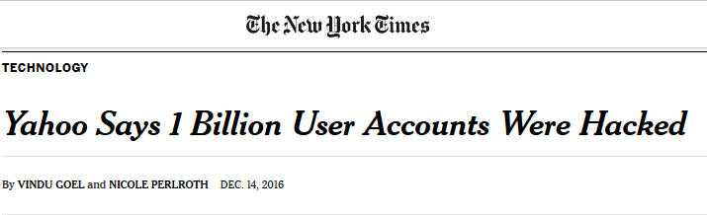
And many more...

Slide 6
Hacking is...?
Exploiting the Weakness
What weakness? A lot of things
Some people are not aware that they are vulnerable.
More threats and we have to start to aware of it.
Sometimes hacker see somethings that are unseen by most people.

Slide 7
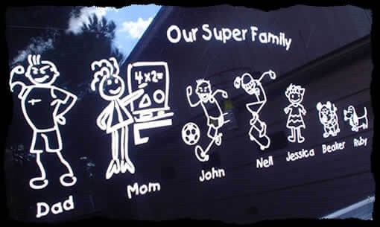
What Hacker See?

Slide 8
Any piece of information might lead to something.
Some important information:
How target is organized
How target reacts to certain event
The knowledge of the system

Slide 9
Hacking Steps
Reconnaissance
Vulnerability Mapping
Exploitation
Post Exploitation
Privilege Escalation
Maintaining Access
Data Exfiltration
Covering Track

Slide 10

The Key Point in Security Field
Programming
Networking
Logic and Problem Solving
Don’t forget about
Social Skills

Slide 11
How can I start learning?
Take course on computer science (seriously)
Participate in competitions
CTF
Wargame
Create Practice Lab

Slide 12
Advice
Be Evil !
Have Fun!

Slide 13

(DEMO) Let’s Pwning!

Slide 14
Being a Professional?
Time to get Serious

Slide 15
Area of Expertise
Network Security
Web Security
Mobile Security
IoT & Embedded System Security

Slide 16
Jobs in Cyber Security Field?
By End of 2016

Slide 17
The Challenges Ahead
The GAP between current us and future world.

Slide 18
Problem? Any Question?

